Slide 1
Twitter Sentiment Analysis
Data Group-5

Slide 2
Table of Contents
Introduction
Why do we need Sentiment analysis?
The 4 Golden Questions
Significance
Challenges faced

Slide 3
Introduction
Twitter sentiment analysis is the process of using machine learning and natural language processing techniques to classify the sentiment of tweets as positive, negative, or neutral, in order to gain insights into public opinion, brand reputation, and customer preferences.
Why do we need it?
Business Insights
Crisis Management
Customer Service
Marketing

Slide 4
The 4 Golden Questions
What is the problem?
Whose problem are we solving?
How do you know the problem is solved?
What is the business outcome/benefit of solving this problem?

Slide 5
Whose problem are we solving?
What is the problem?
Twitter Sentiment Analysis is to analyze the tweets being generated everyday and classify them as positive, negative, or neutral based on the sentiment they express.
The goal is to extract meaningful insights from the data, such as identifying popular topics, understanding public opinions, or predicting future trends.
Twitter Sentiment Analysis can be used to solve the problem of understanding how people feel about topic on Twitter.
This information can be useful for businesses, marketers, researchers to gain insights into public opinion, identify customer satisfaction levels.

Slide 6
What is the business outcome of solving this problem?
How do you know the problem is solved?
The problem of understanding public opinion or sentiment on a particular topic can be considered solved using Twitter Sentiment Analysis.
By analyzing the sentiment of tweets, organizations can make data driven decisions based on the insights gathered from twitter users.
Improved customer satisfaction
Improved Product development
Increased brand reputation
Better marketing campaigns

Slide 7
Technologies Used
Python, Machine Learning
Model Used
Machine Learning
UI Tool Used
Power BI

Slide 8
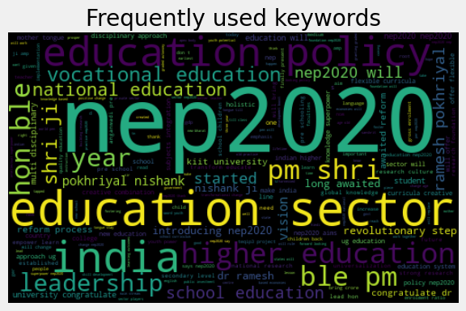
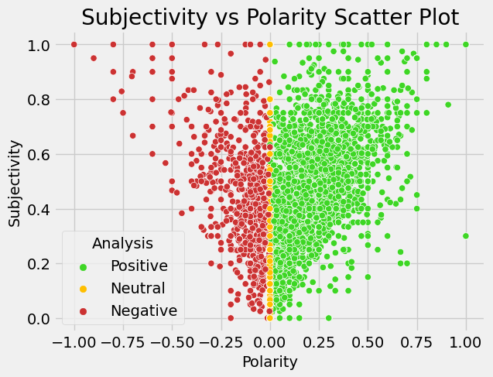
Significance of Charts

Slide 9
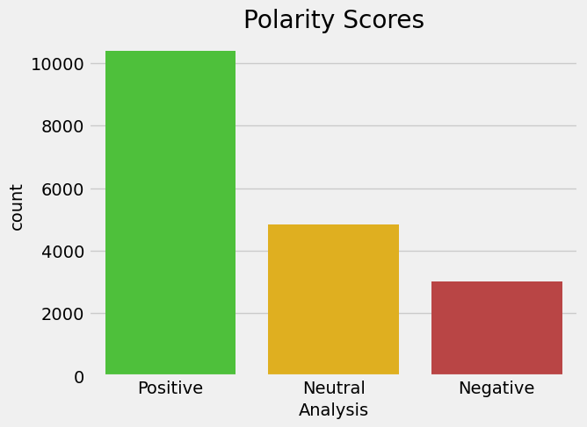
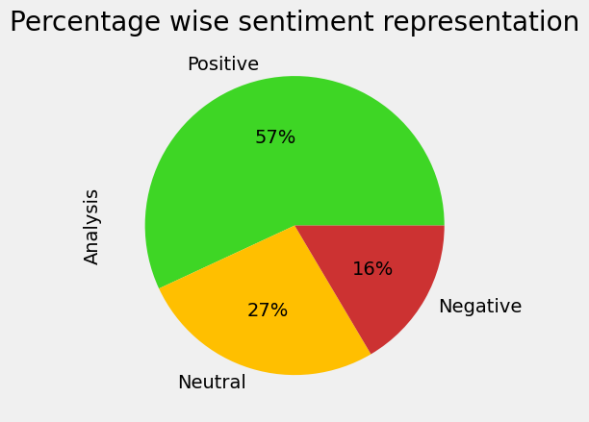

Slide 10
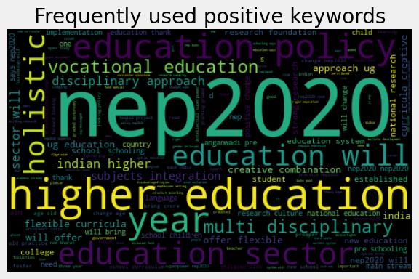
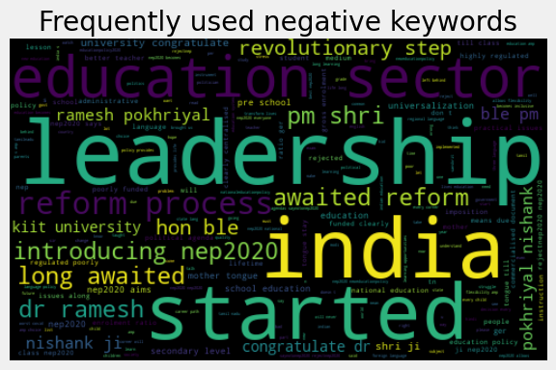
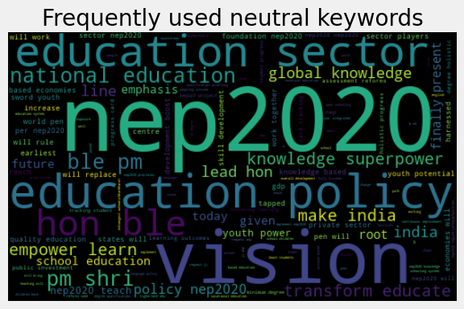

Slide 11
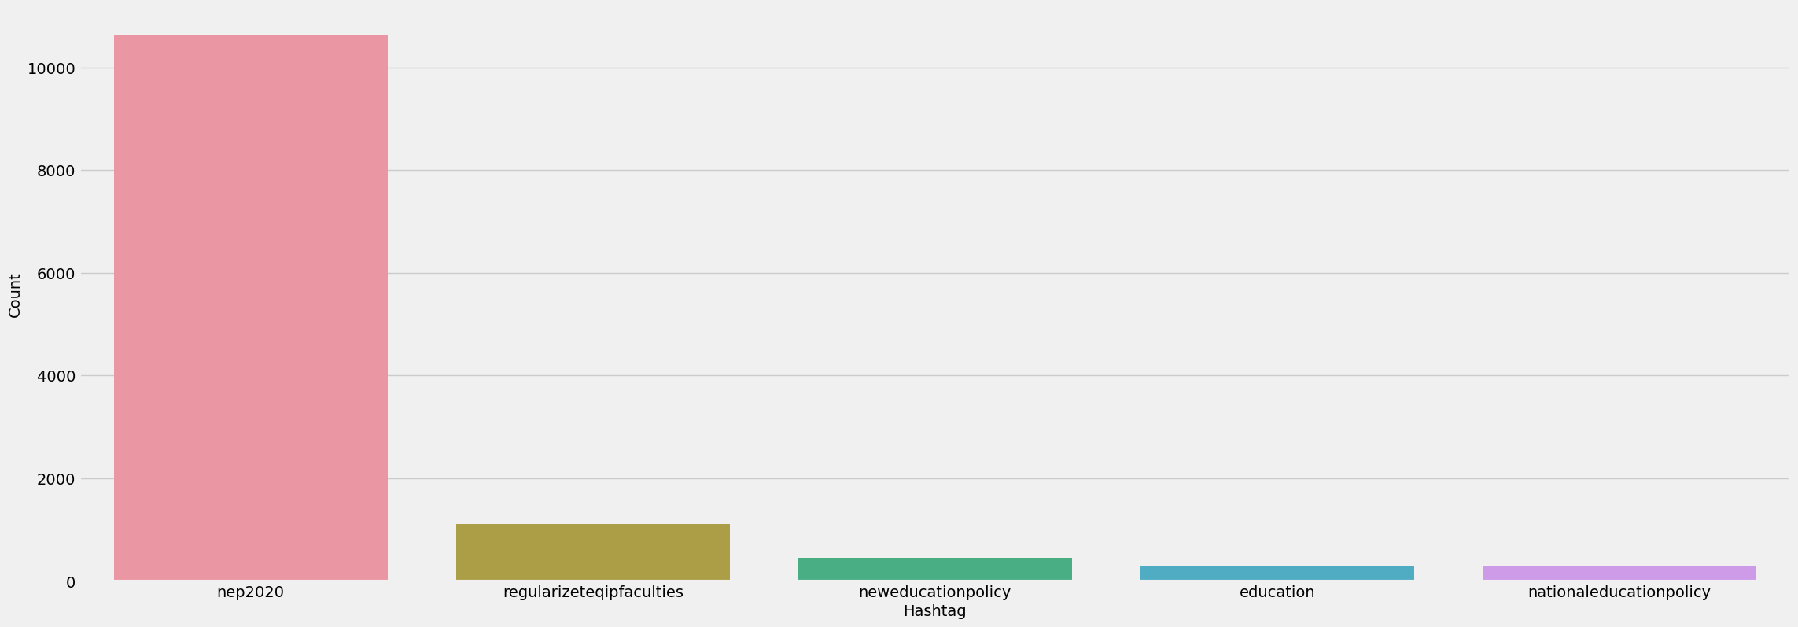
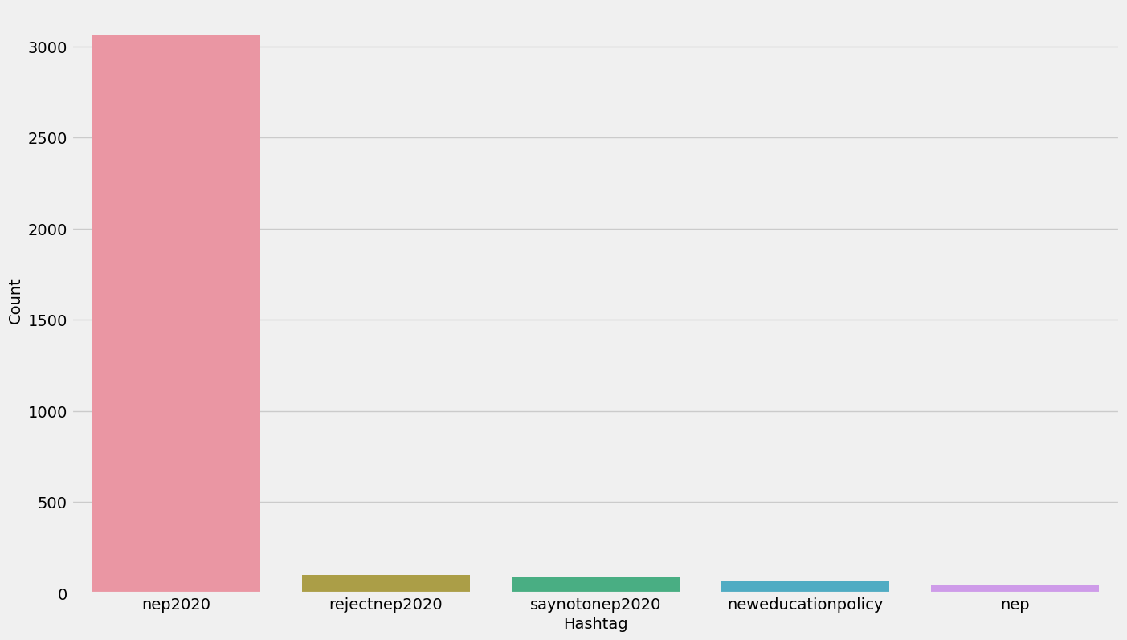
Extracting hashtags from Positive Tweets
Top 10 Hash Tags

Slide 12
Challenges faced
Twitter users often use Sarcasm and Irony to convey their message. It can be challenging for sentiment analysis to interpret accurately.
Twitter users often use slang, abbreviations and misspellings which can make it difficult for sentiment analysis models.
Sheer volume of tweets can be time-consuming and resource-intensive to analyze large amount of data.
Twitter users frequently use emojis and emoticons to convey their emotions.

Slide 13
Thank You

